Slide 1
SYSTEM MODELING AND PROTOTYPE Phase III
Prepared by Elementary Engineers:
Olga Sheehan, Sara Hakkoum,
Eric Holm, Ethan Fiero
Framingham State University
14 April 2016

Slide 2
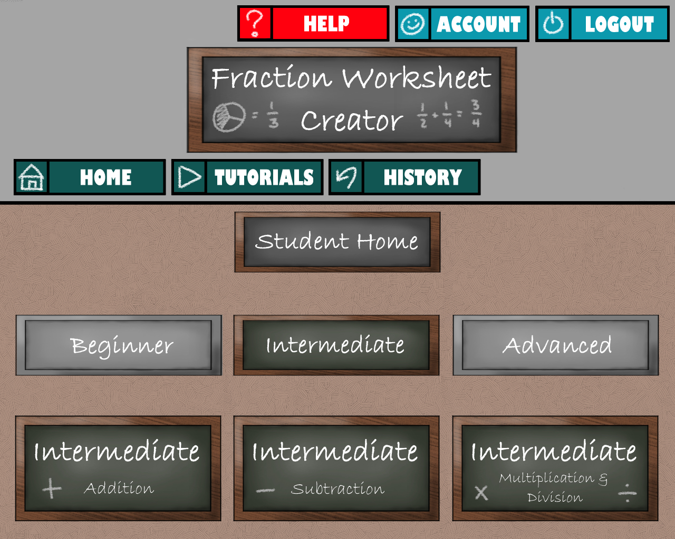
Graphical Mockup

Slide 3
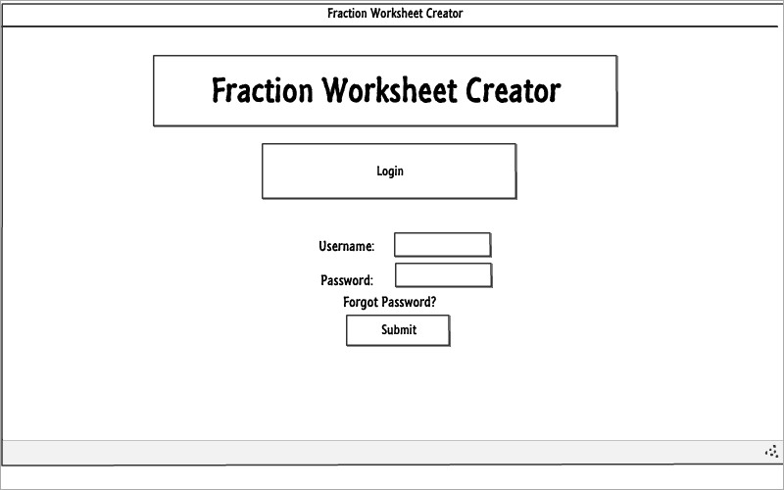
LOGIN

Slide 4
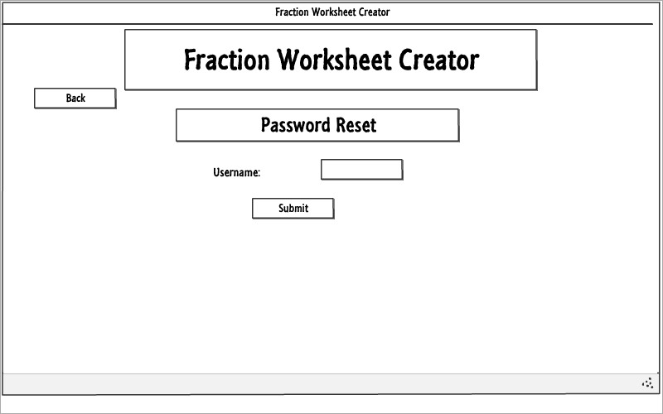
Teacher Forgot the password

Slide 5
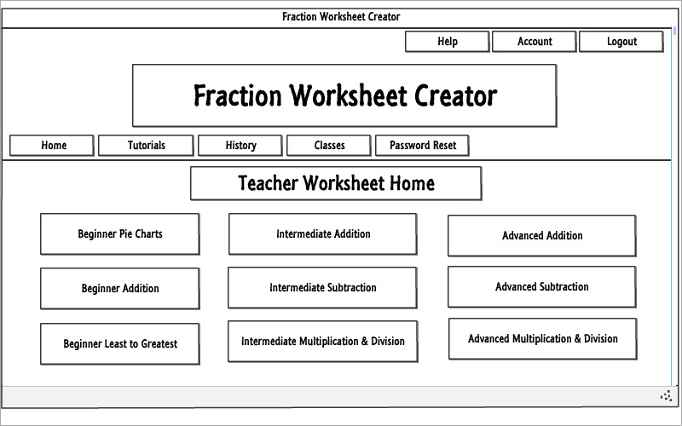
Teacher Home

Slide 6
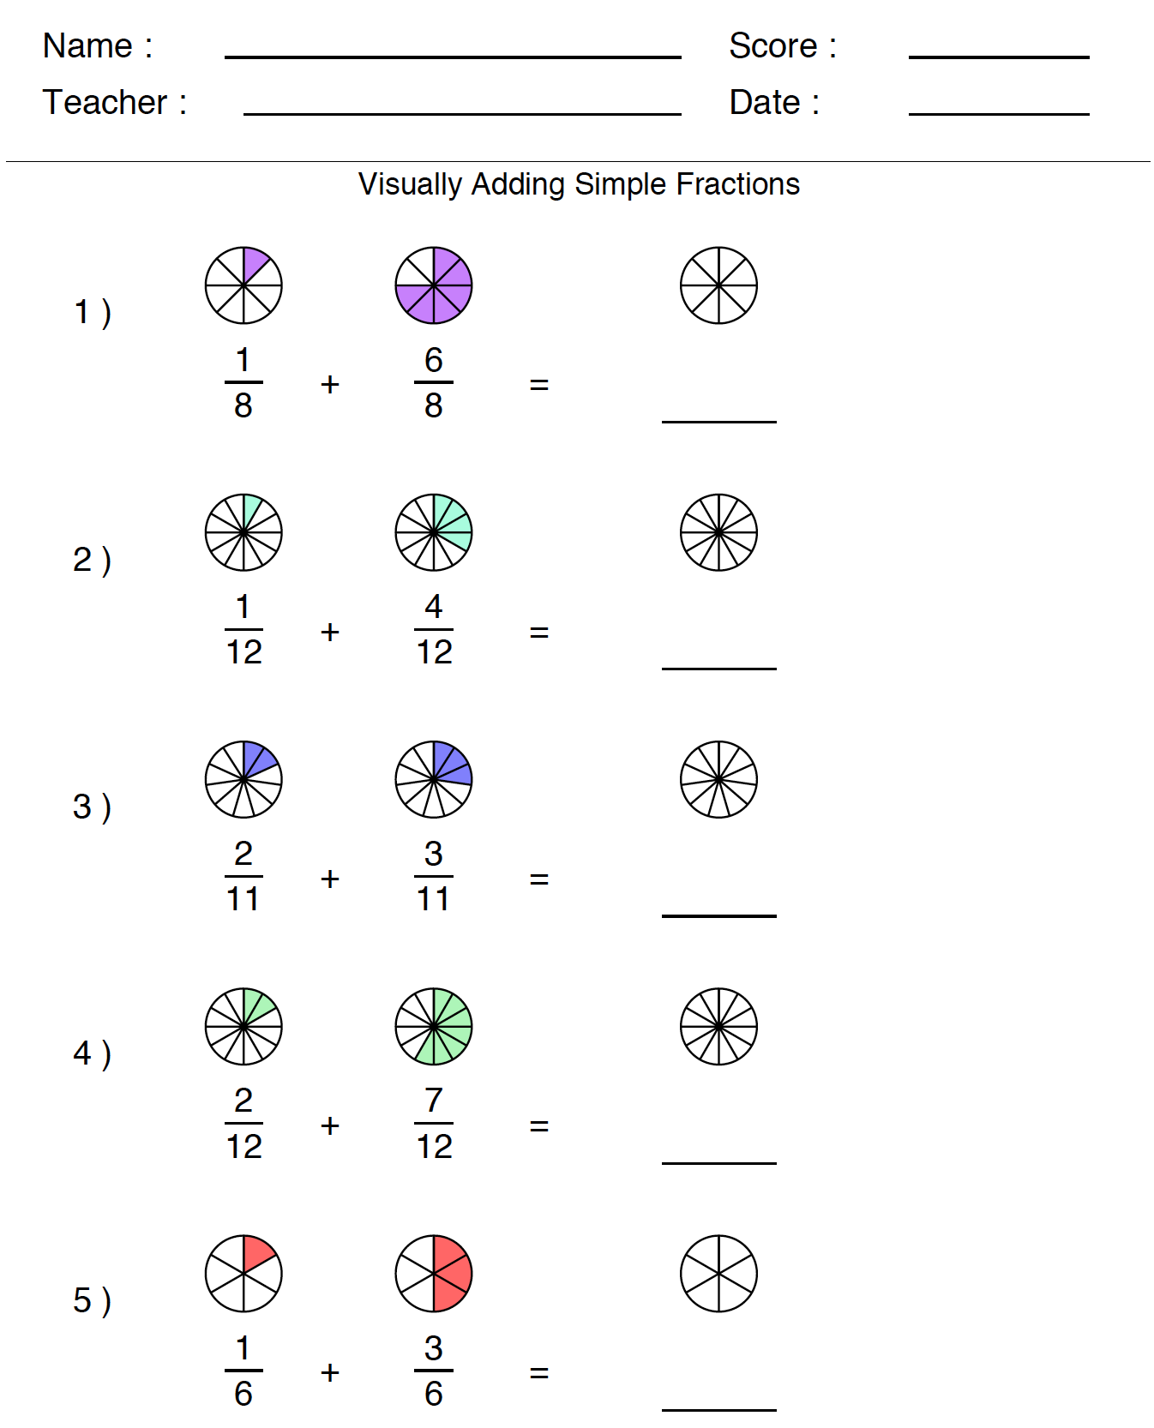
Example Worksheet

Slide 7
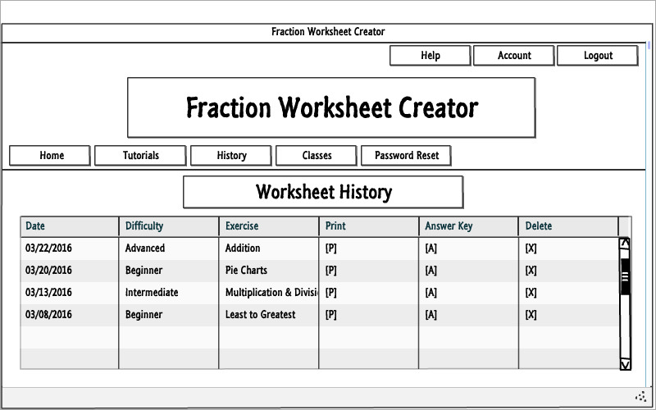
Teacher – Worksheet History

Slide 8
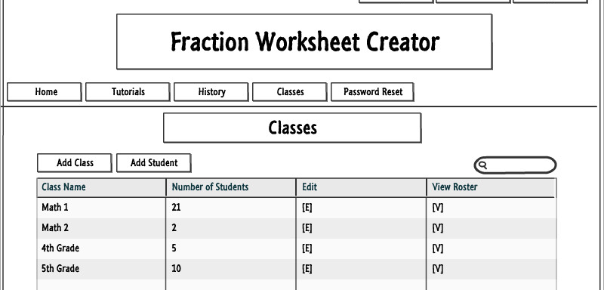
Teacher - Classes

Slide 9
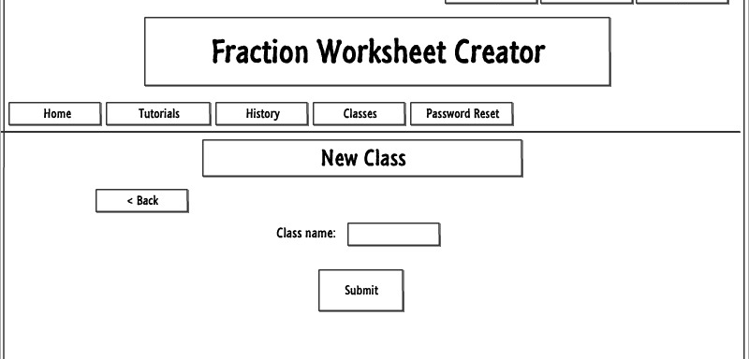
Teacher – Adding a New Class

Slide 10
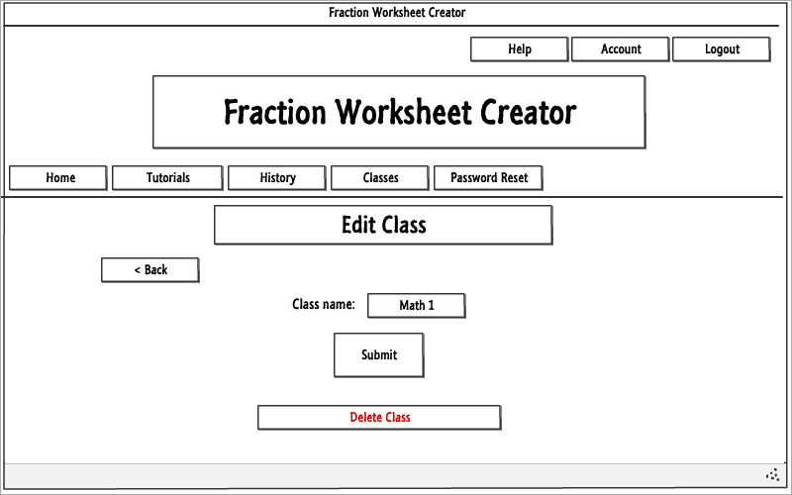
Teacher - Edit Class

Slide 11
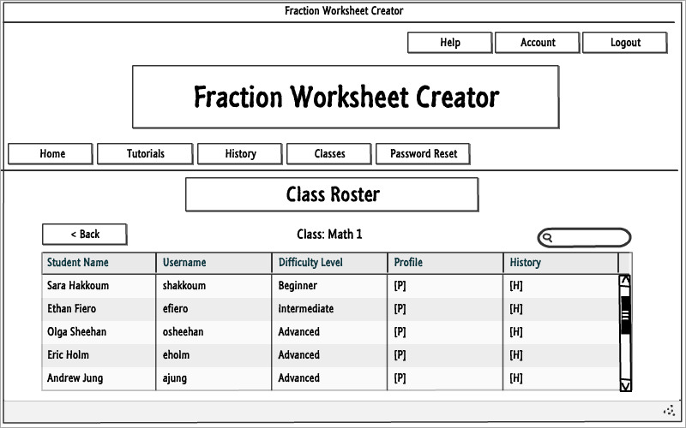
Teacher – class roster

Slide 12
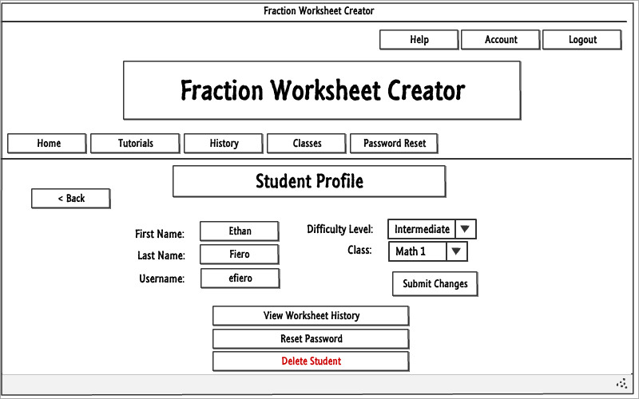
Teacher – student profile

Slide 13
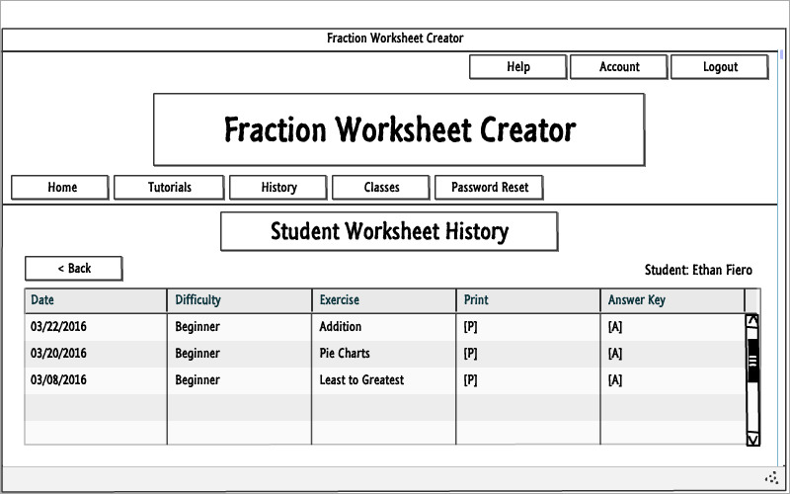
Teacher – Student Worksheet history

Slide 14
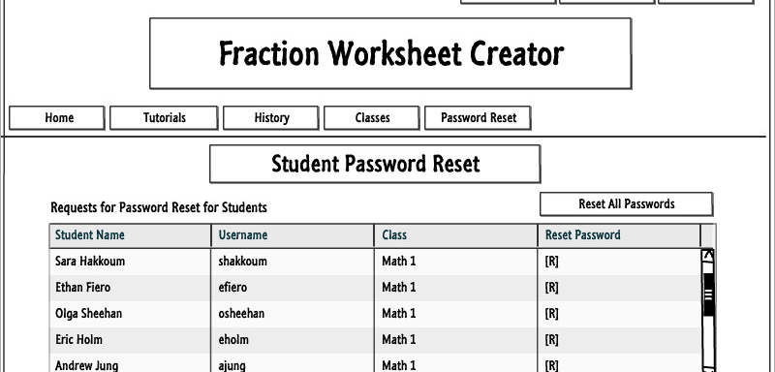
Teacher – Student Password reset

Slide 15
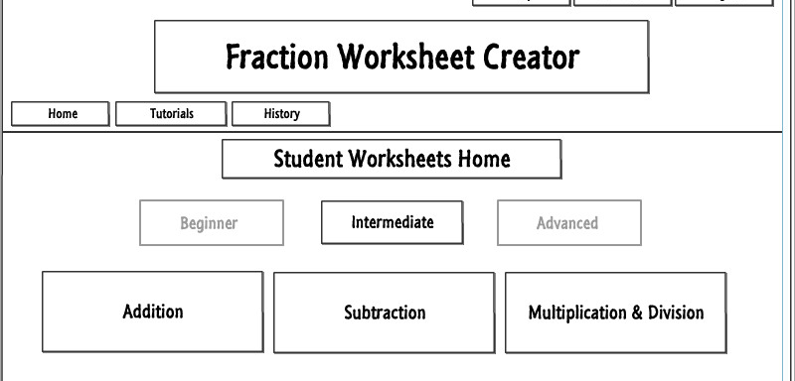
Student - home

Slide 16
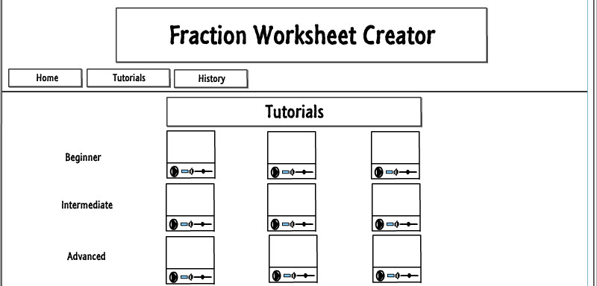
All users - tutorials

Slide 17
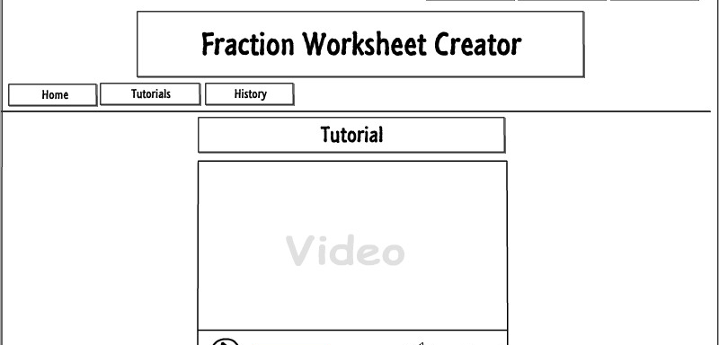
Single tutorial

Slide 18
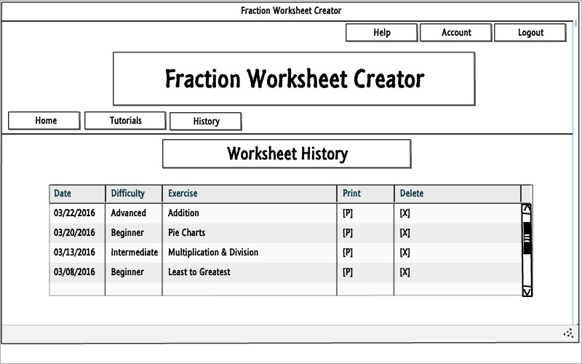
Student worksheet history

Slide 19
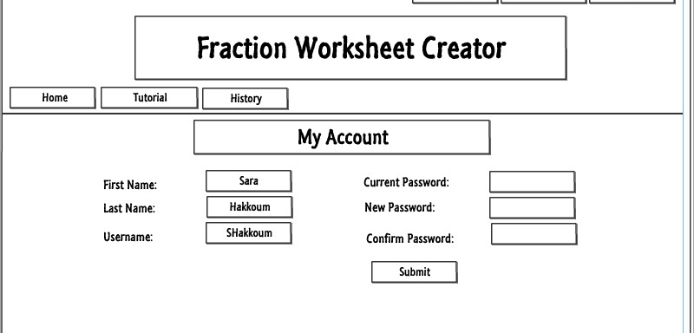
My Account

Slide 20
Questions?

